Slide 1
SUP SAT
United States Air Force Academy
Junhyung Park

Slide 2
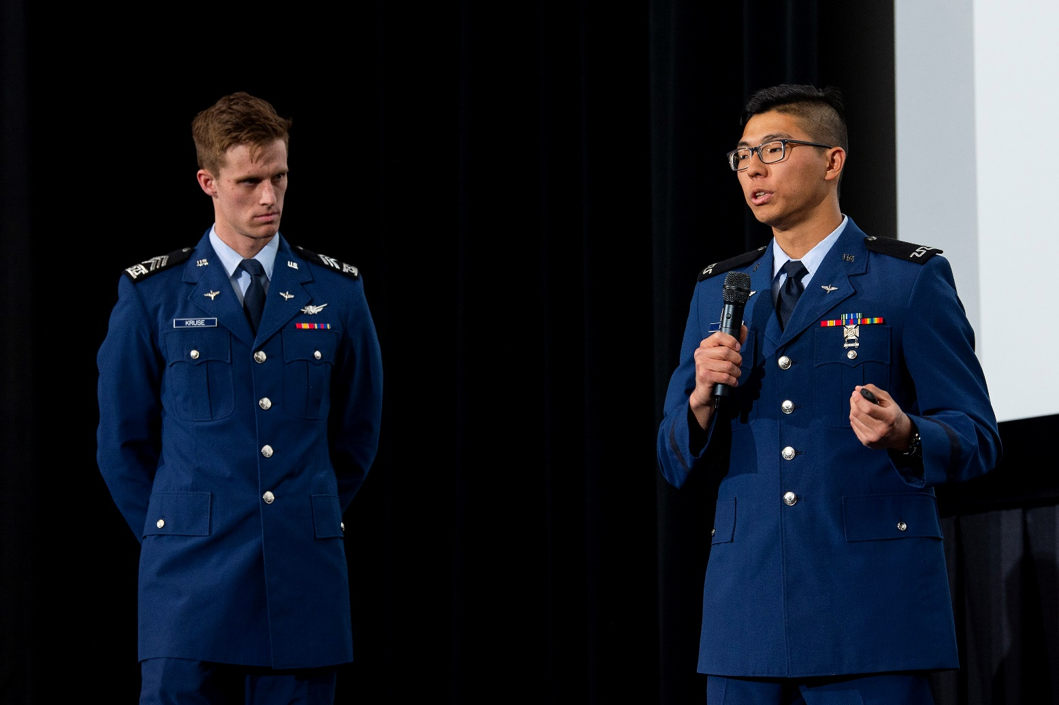
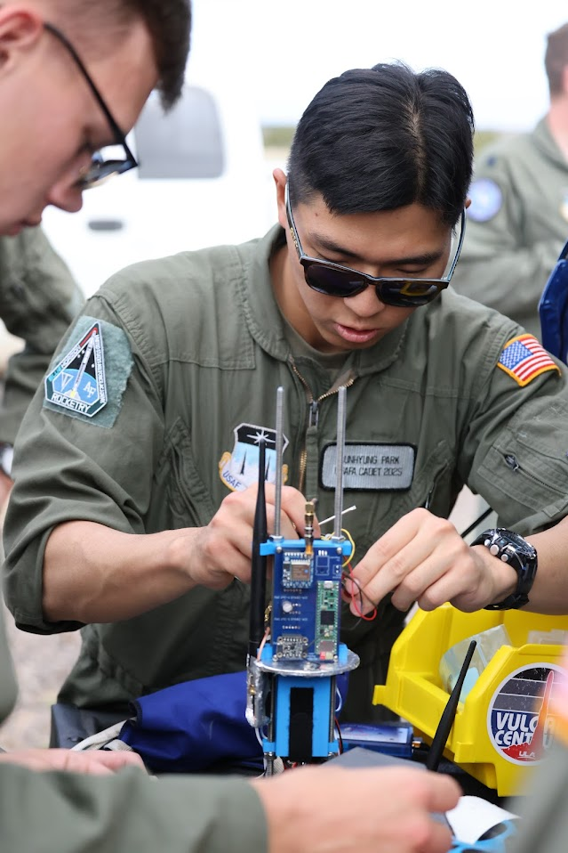
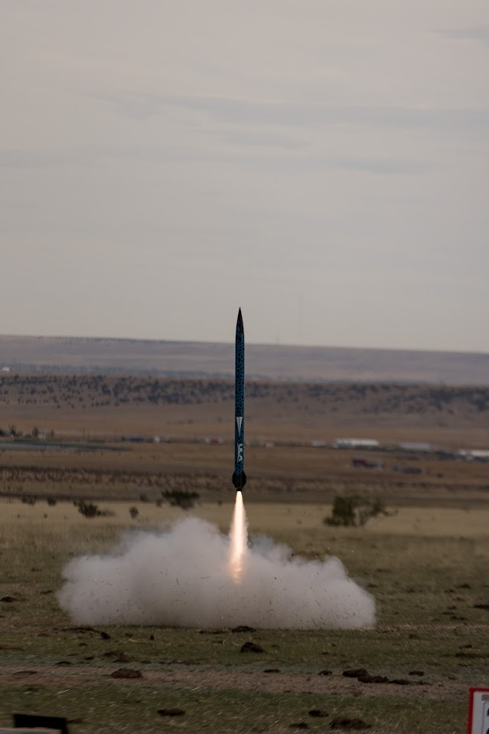
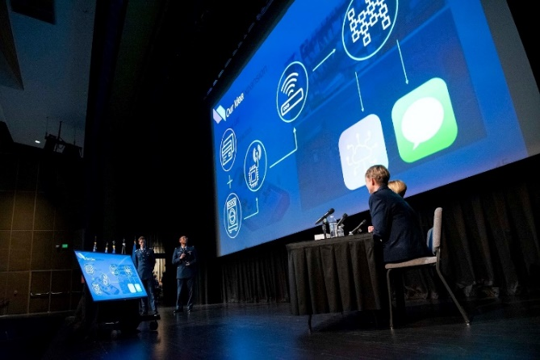
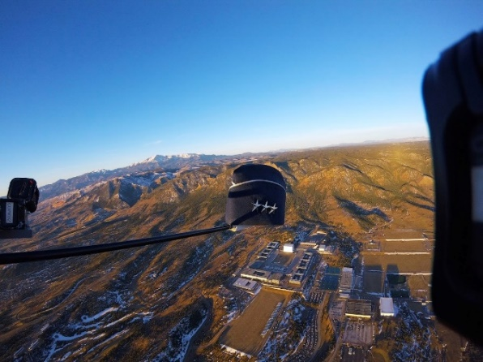
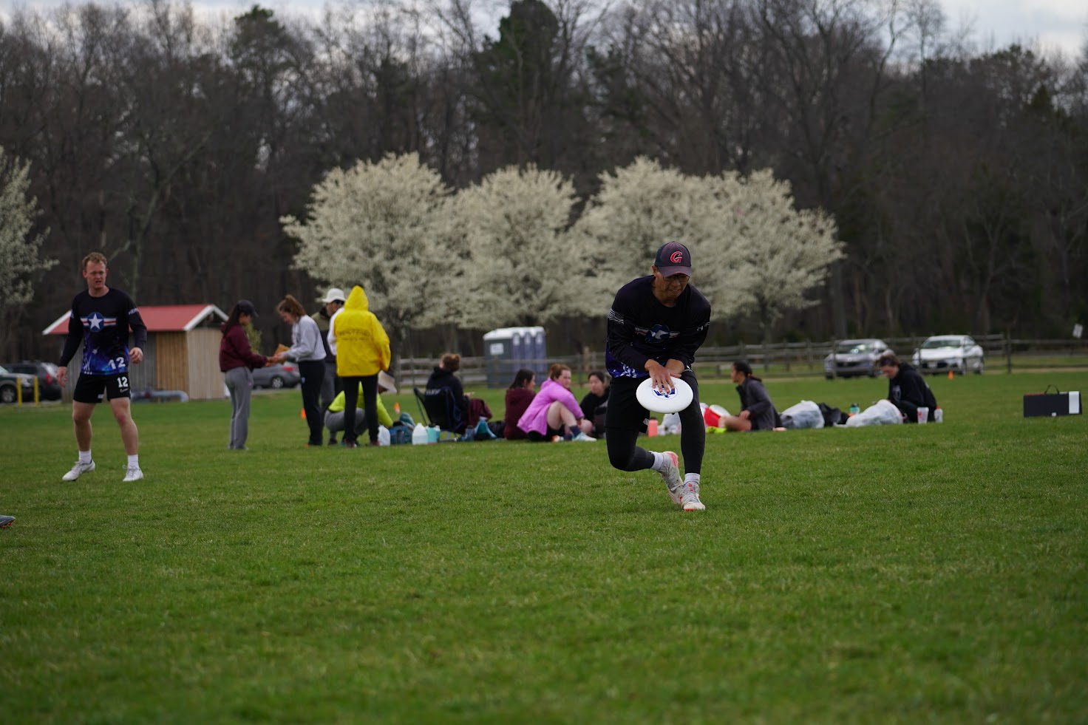
Junhyung Park
BS: Electrical and Computer Engineering
Minor: Spanish
Electronics Team Lead for Blue Horizon Rocketry Club
Software Engineer for Weather Balloon Research
FalconTank Contestant/SPARK
D-III Men’s Ultimate Frisbee

Slide 3
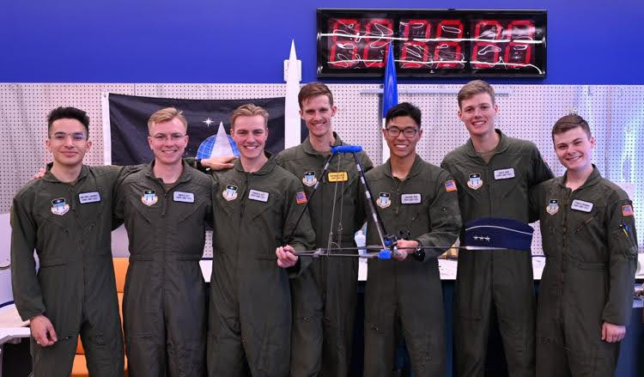
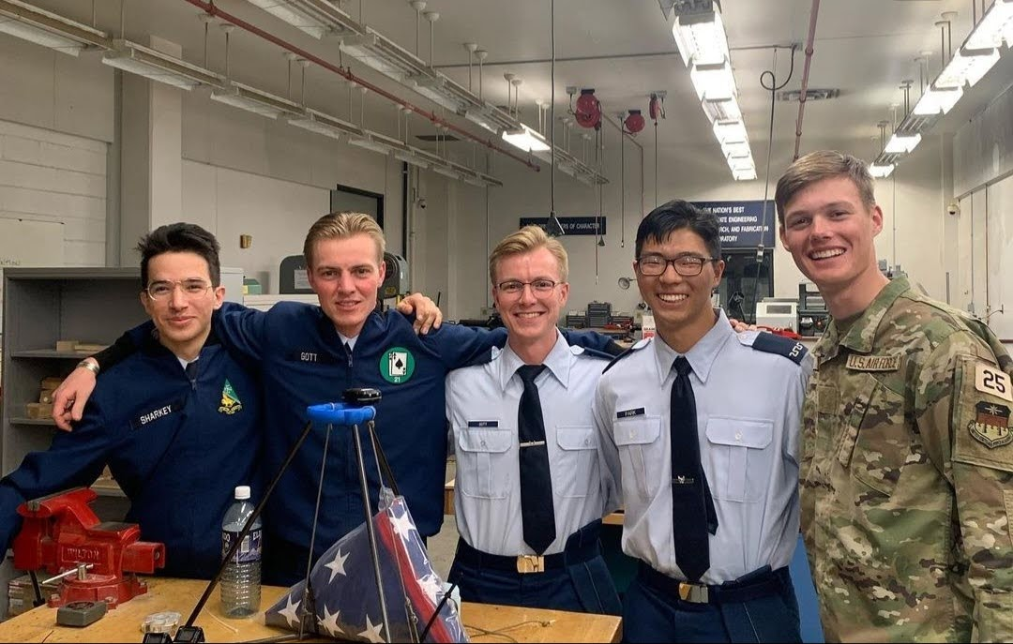
Team Members
Junhyung Park - ECE
Simon Gott - ECE
Gunnar Gott – ECE
Shepherd Kruse – Astronautical Engineering
Jack Arne – Aeronautical Engineering
Matthew Sharkey – Aeronautical Engineering
Ethan Lefebvre – Computer Science

Slide 4
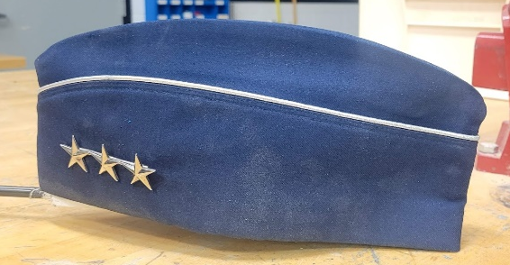
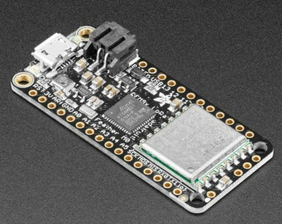
Goals
Spirit Mission: A tradition that the first-year cadets do a special activity to raise the morale of the students through tough, grueling academic and military life.
Send three-star general’s flight cap to near-space!
Research
Long Range Wide Area Network (LoRaWAN) Radio Transmission System
Cheaper weather balloon research!

Slide 5
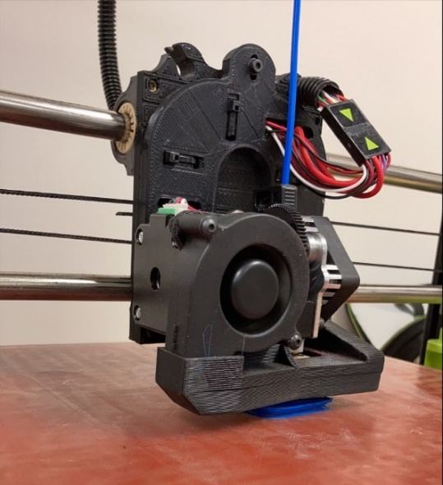
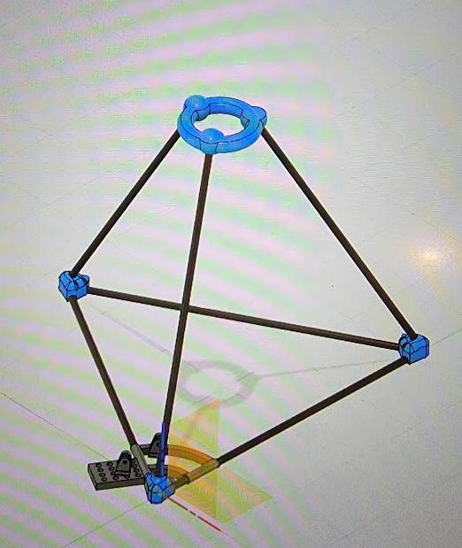
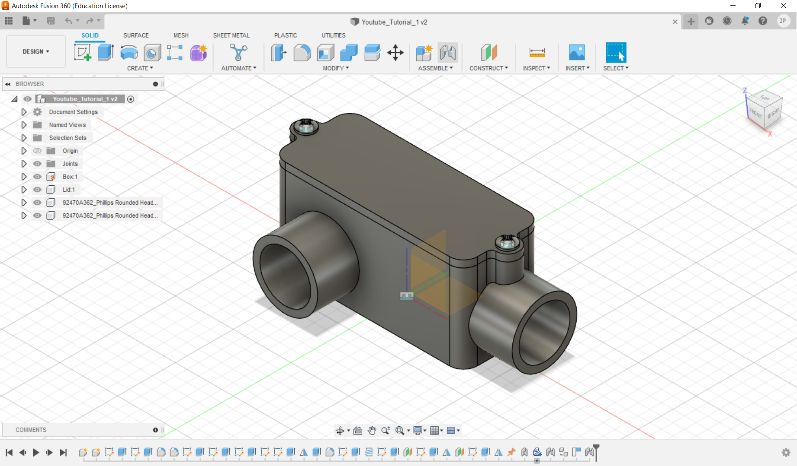
Structure Development
Fusion360 CAD software
3D Print

Slide 6
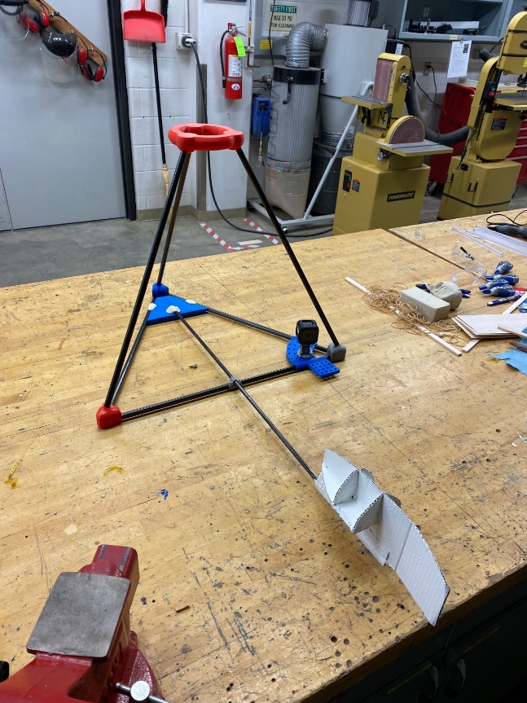
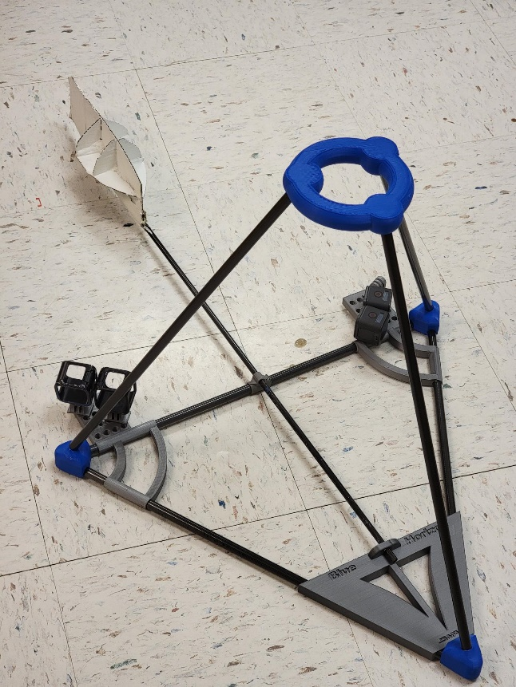
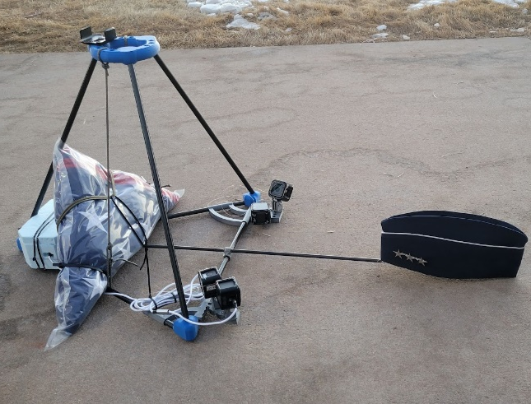
Progress

Slide 7
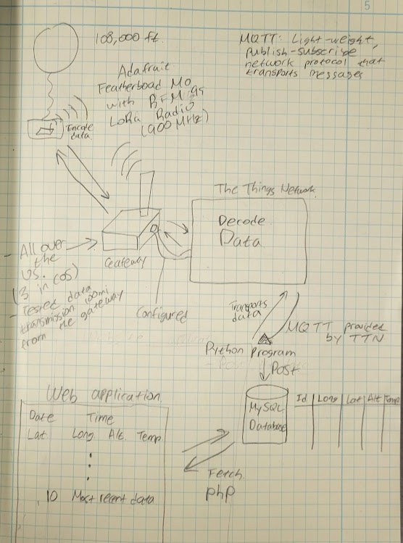

Electronics Infrastructure
Components
Microcontroller
GPS
Temperature Sensor
Internet of Things (IoT)

Slide 8
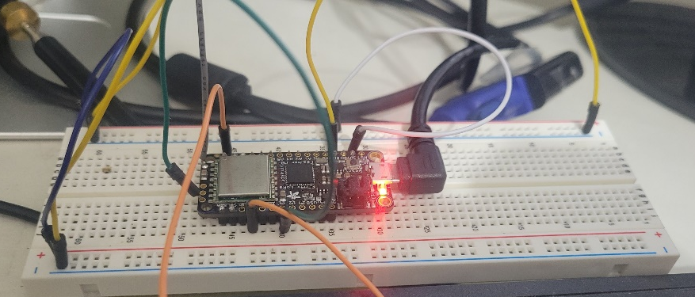
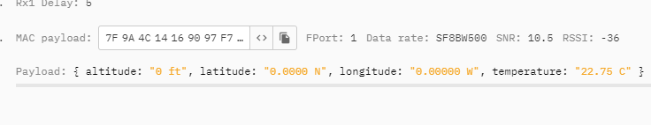
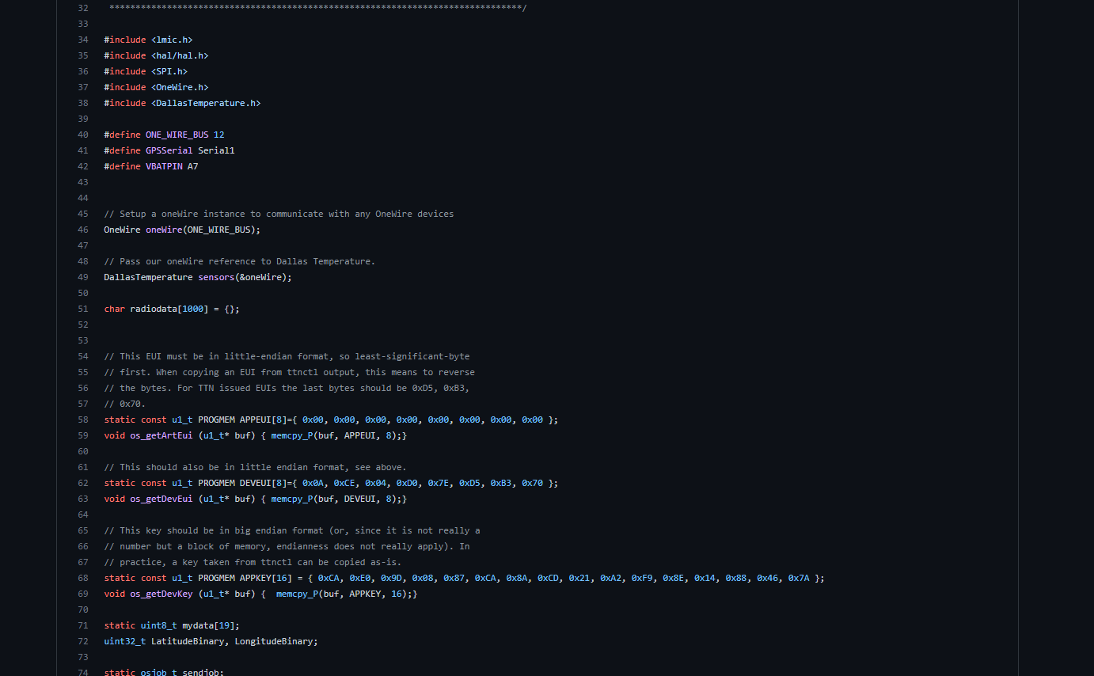
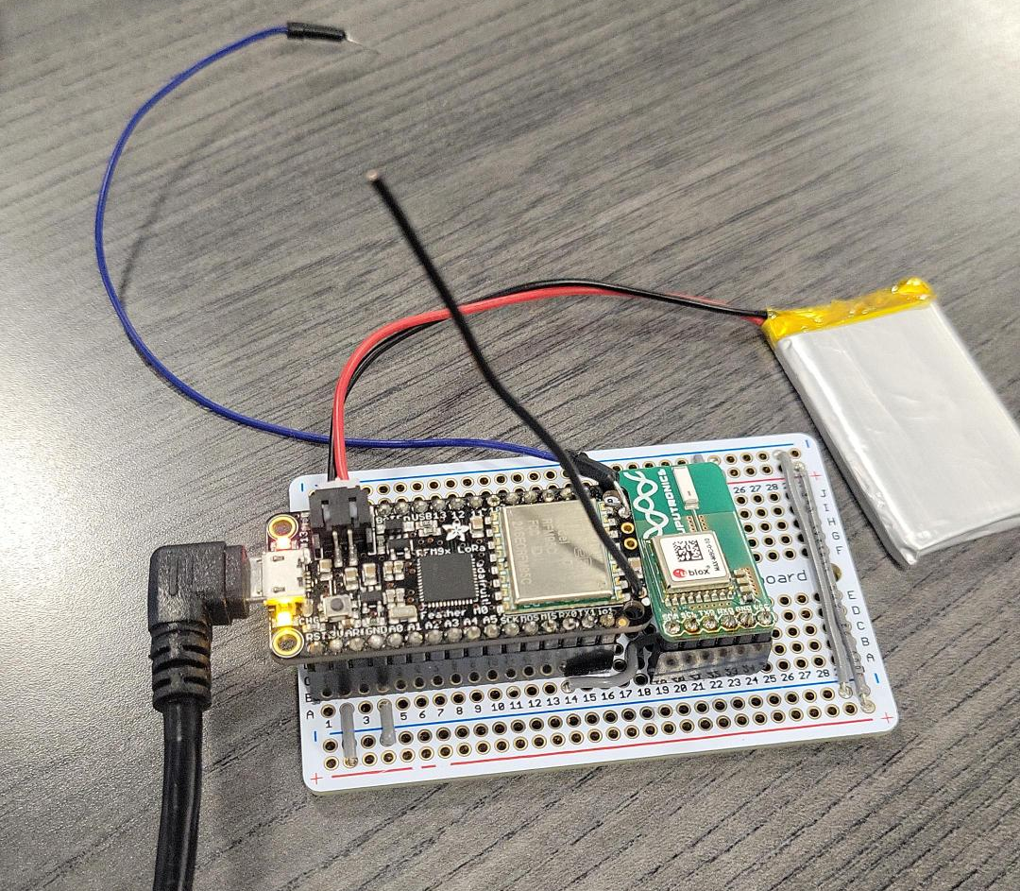
Payload Development

Slide 9
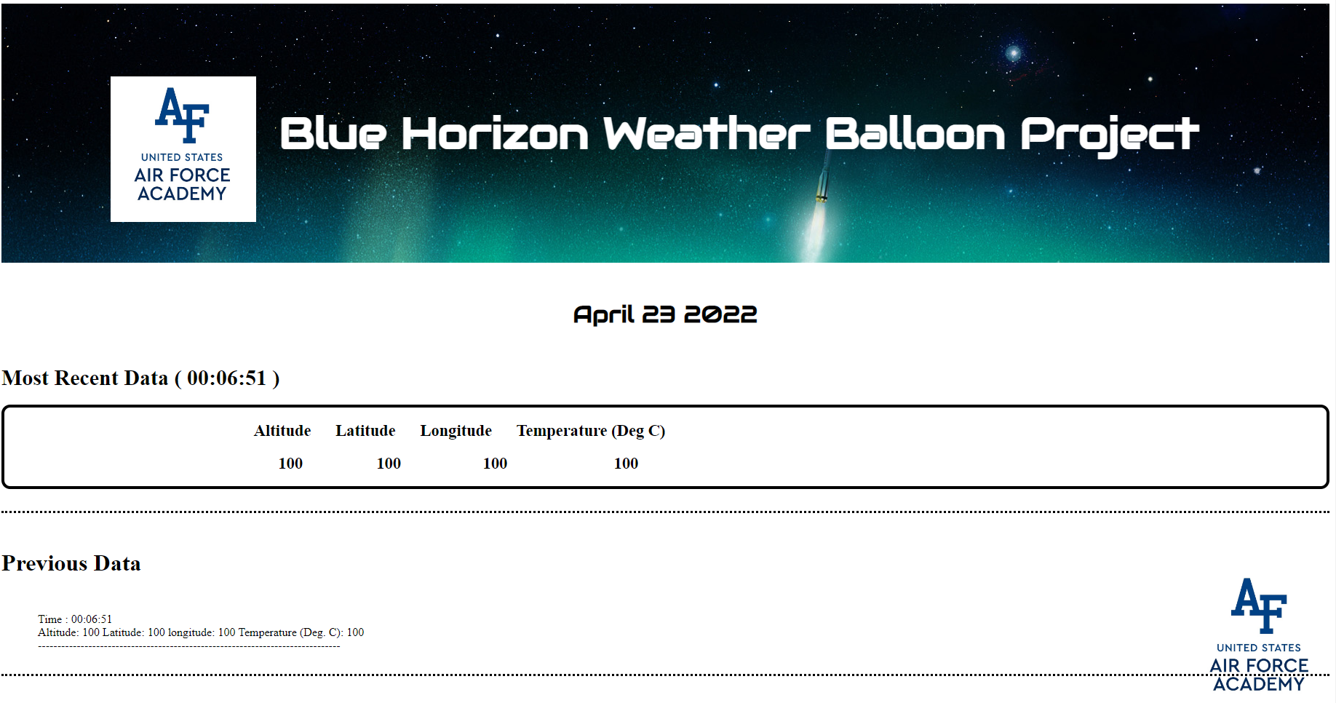
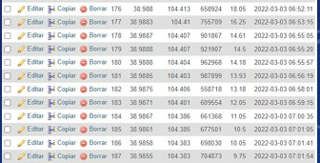
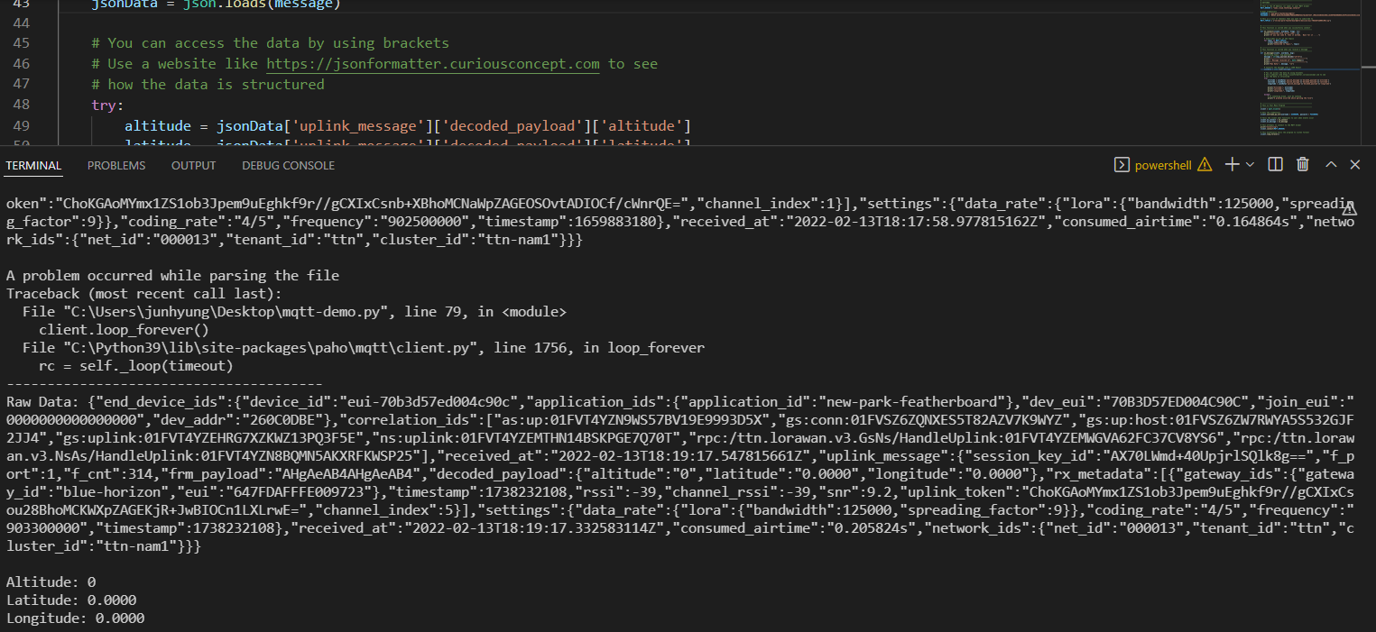
User Interface Development

Slide 10
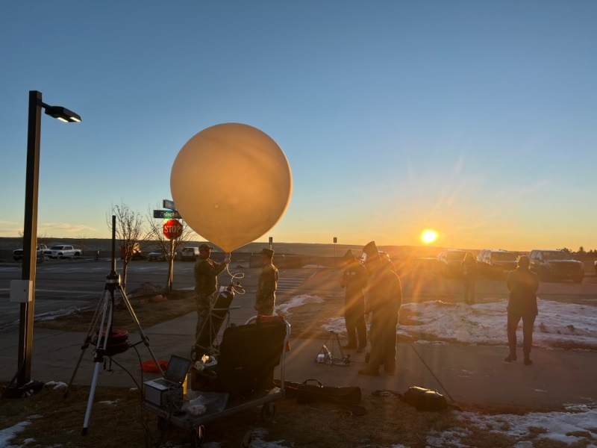
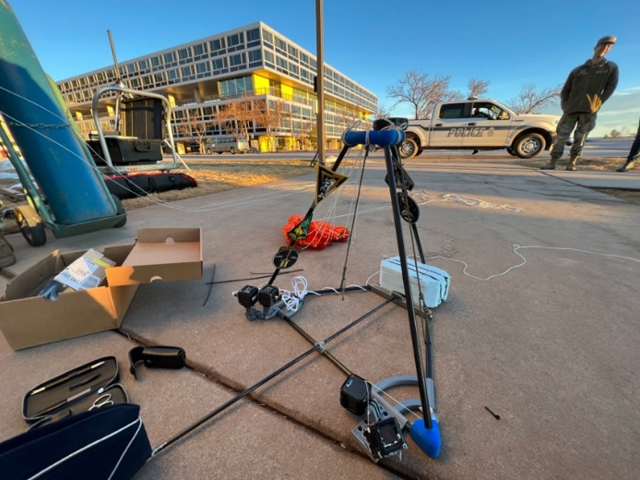
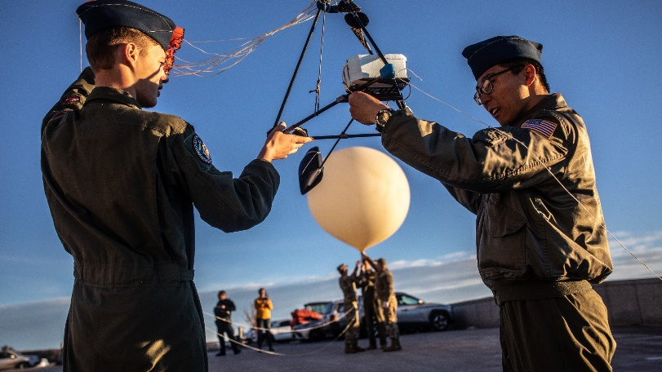
Launch Day
137 ft³ of helium​
4.29 kg of lift​
1000 g balloon​
900g of free lift​
Liftoff at 0650 ​

Slide 11

Video

Slide 12
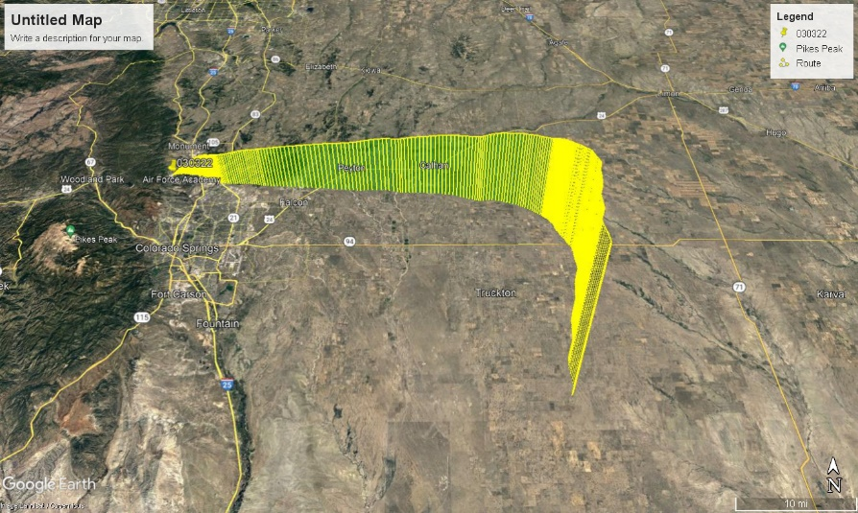
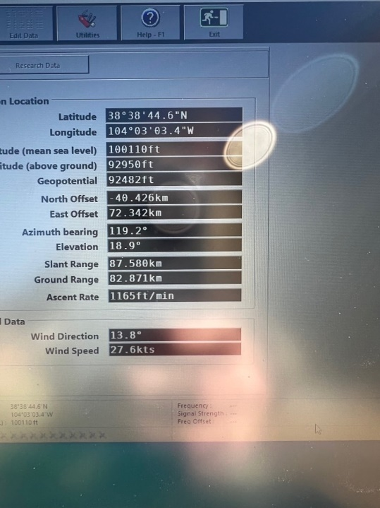
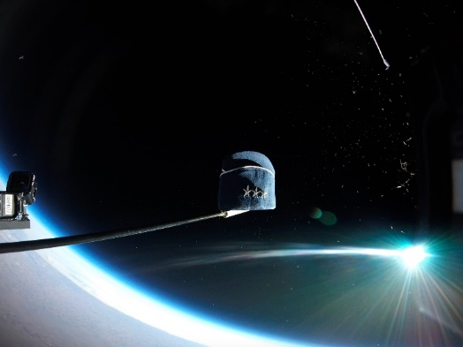
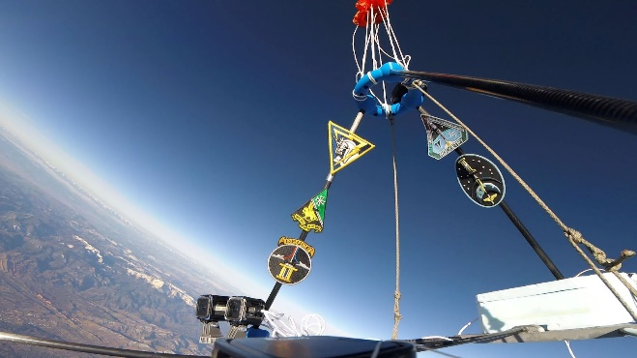

Result
Apogee 108,000 ft ​
Total flight time 2h 8mins 14sec​
Descent time 20mins​

Slide 13
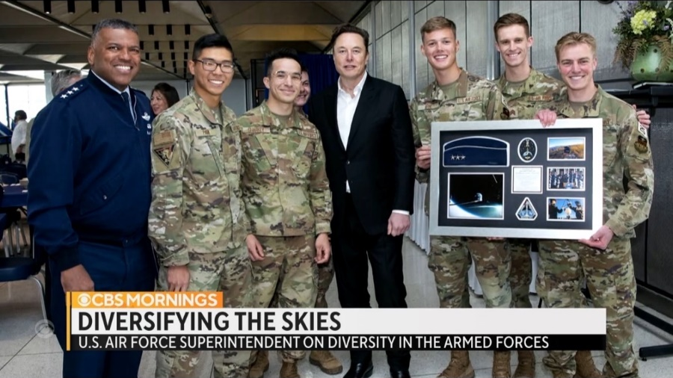
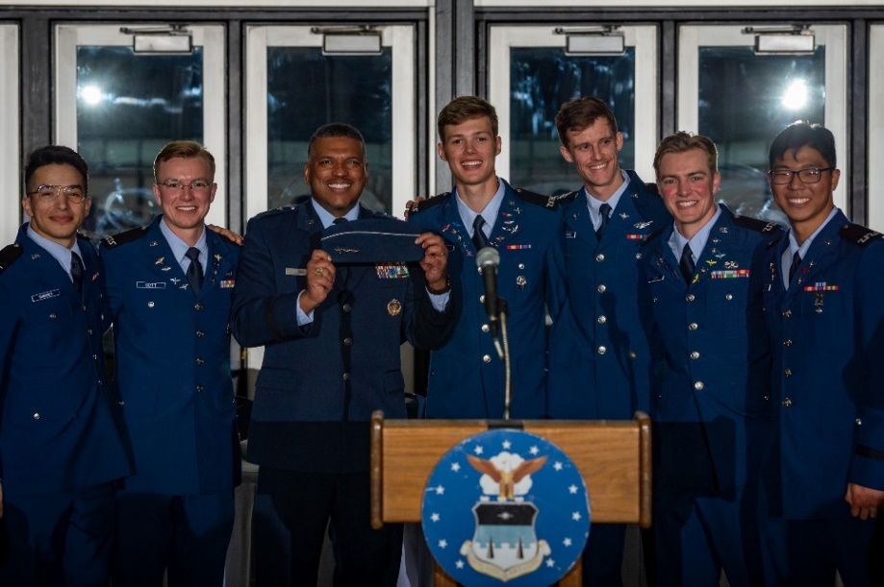
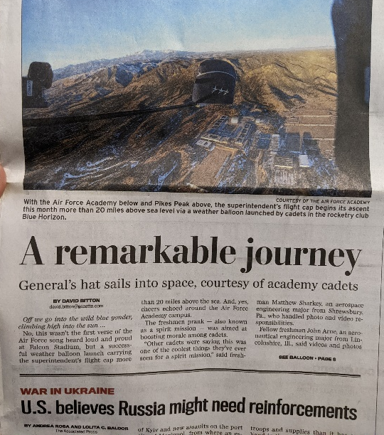
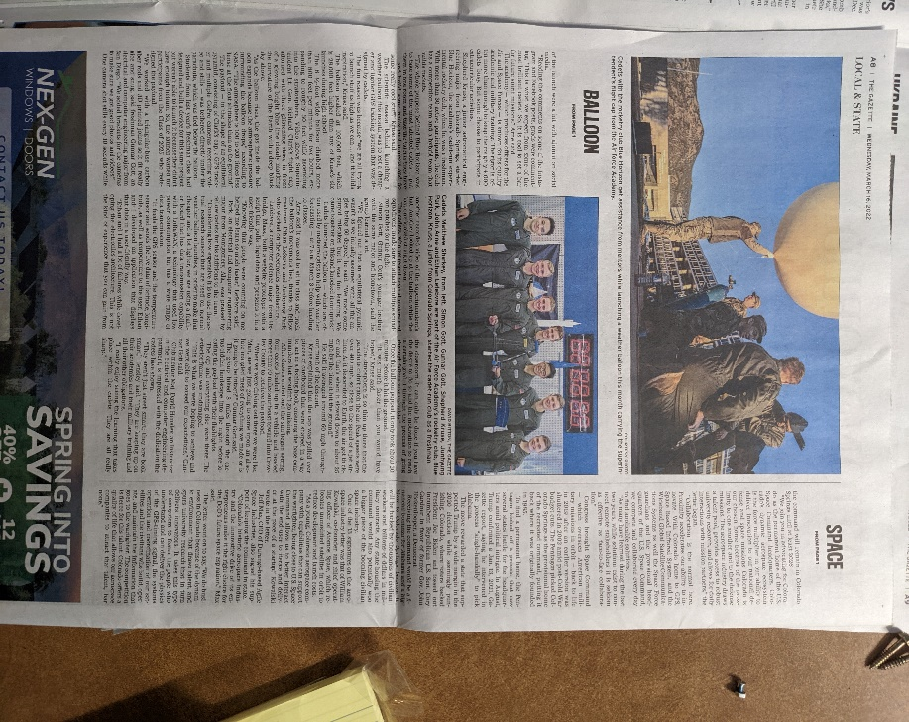
Impacts

